Slide 1
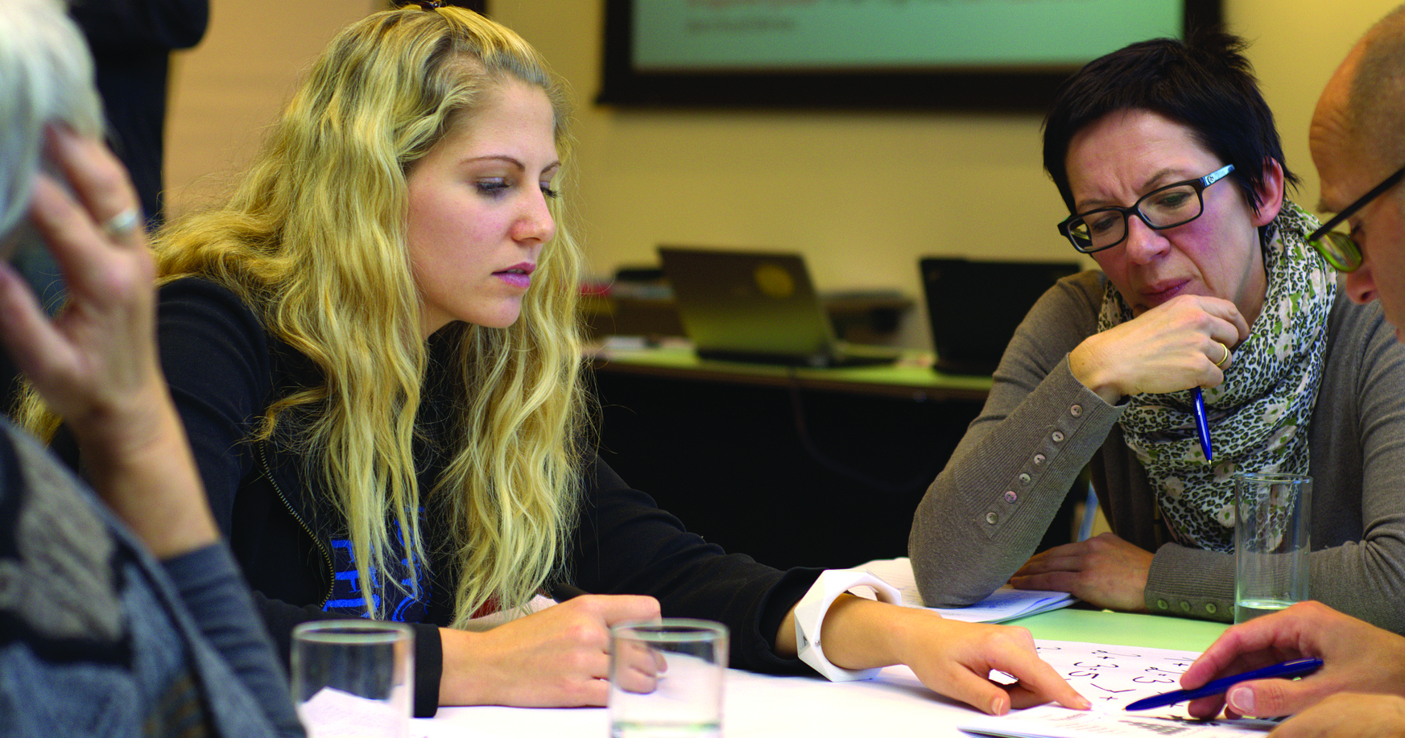
The Best Programming Languages
ricky brown, Hamid nahli, jesse law, Mimi Southwood, Nichelle garvey
It 115, group 2
SPRING 2022

Slide 2
Team and Project Management

Slide 3
JESSE - How did you change Code Compare?
GitHub -> Code Compare
READ.ME
CONTRIBUTING.md
License
index.html
styles.css
plan.html
Powerpoint presentation
Secondary Survey repo

Slide 4
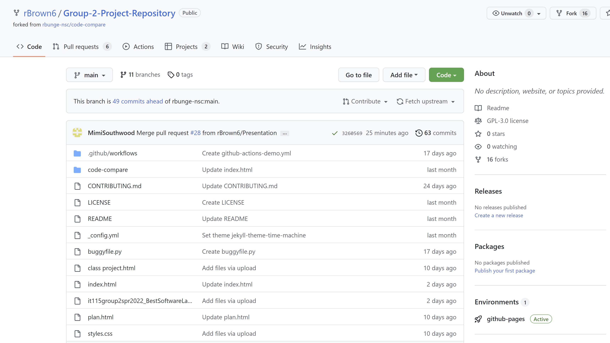
MIMI – Team Collaboration, Project Management, Roles, Project Page
Collaboration
GitHub – files, updates
Email – communication
Project management – plan.html
Roles – Division of group deliverables – plan.html
Content on Project Page
Project page - index.html, styles.css
Survey – separate repo

Slide 5
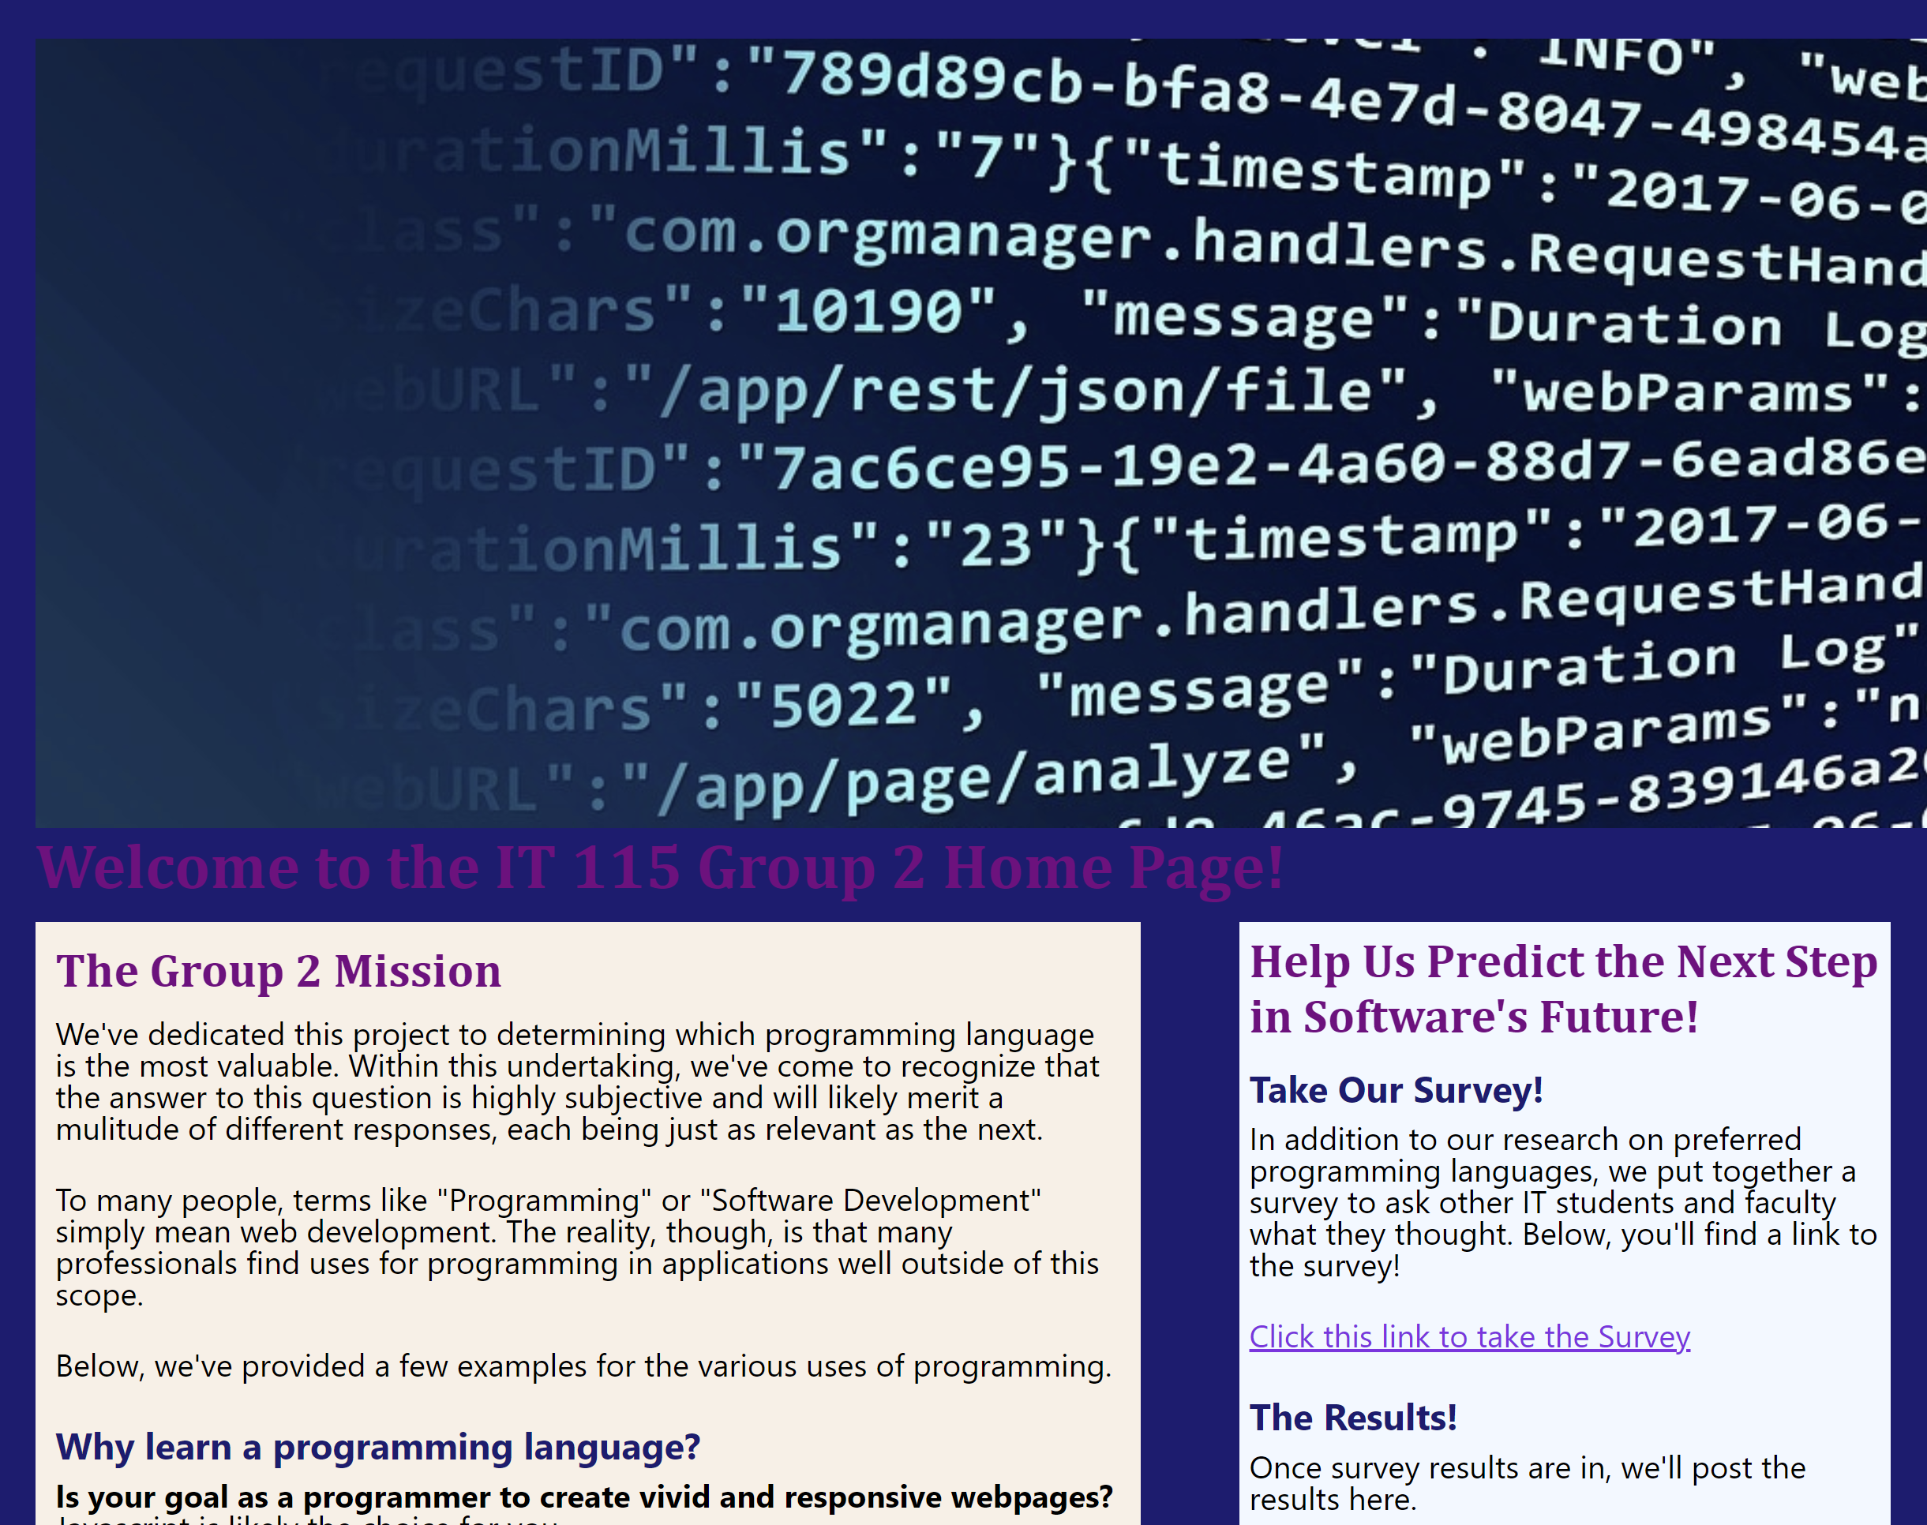
MIMI – Project Page, Content
Team Contributions
Mission
Programming language recommendations
Survey results

Slide 6
NICOLE – Testing, Bug Tracking, and Updating and Fixing Code
4. Bug reports project board

Slide 7
NICOLE – Bug reports project board

Slide 8


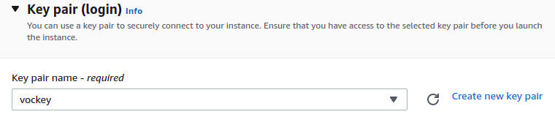
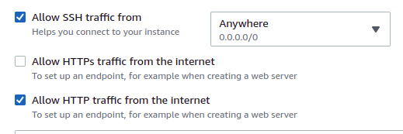
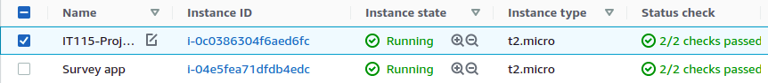
Web Server Hosting
We chose to use two separate AWS EC2 instances to host the web content for both our general project page and our Survey application.
The servers were configured using the free Ubuntu 20.04 version, and connected via SSH using a new key pair created with the included tool.
In Network Settings, we enabled traffic from SSH in order to connect remotely to the server using PuTTY, and HTTP for use as a public server
Finally, we can see our two instances running without issue.

Slide 9
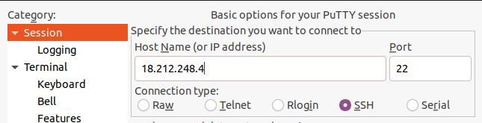
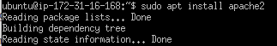



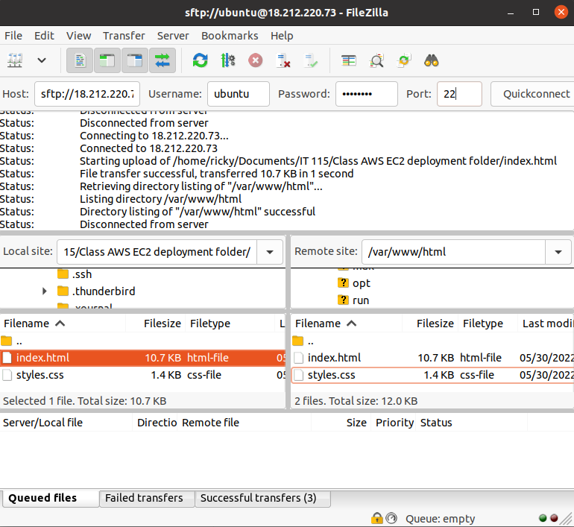
Web Server Configuration
To connect to our newly configured instances, we connected via PuTTY using our newly created SSH key pair.
Once in, we ran an update and installed Apache2 as our web server. Now our instances' Public IPv4 addresses were the host addresses for our servers.
In order to get our webpage and application files onto the servers, we used FileZilla.
Once our required files had been moved into the /var/www/html directory in the instance, our webpage and application content was up and running!

Slide 10
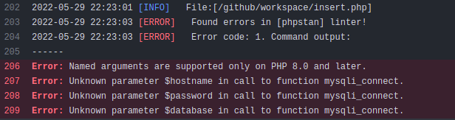
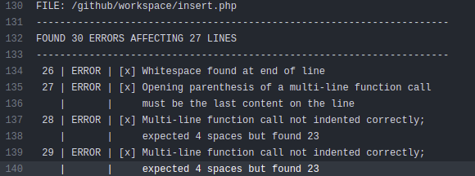
Super-Linter Workflow
Super-Linter showed its usefulness when it came to creating the survey part of our project, particularly within building the back-end elements. The application worked by tying an HTML front end framework together with a MySQL database server that existed on our AWS EC2 instance, using PHP as the business layer. With none within our group having any experience using PHP, an automated testing tool like Super-Linter was helpful. Though It certainly cannot serve as a stand-in for lack of programming knowledge.

Slide 11
HAMID – Deploying Code to the Server, URL for Testing

Slide 12
HAMID / RICKY – Summary of Project Pages, Assets

Slide 13
Our Survey
RESULTS?

Slide 14
Team Recommendations
HTML – Ricky Brown
CSS – Nicole Garvey
JavaScript – Jesse Law
SQL – Mimi Southwood
Python – Hamid Nahli

Slide 15
Thank you!

